Slide 1

SIMGOS Cheat Sheet
Report
By: Heri.Muryanto@gmail.com 08 123 30 10 987

Slide 2
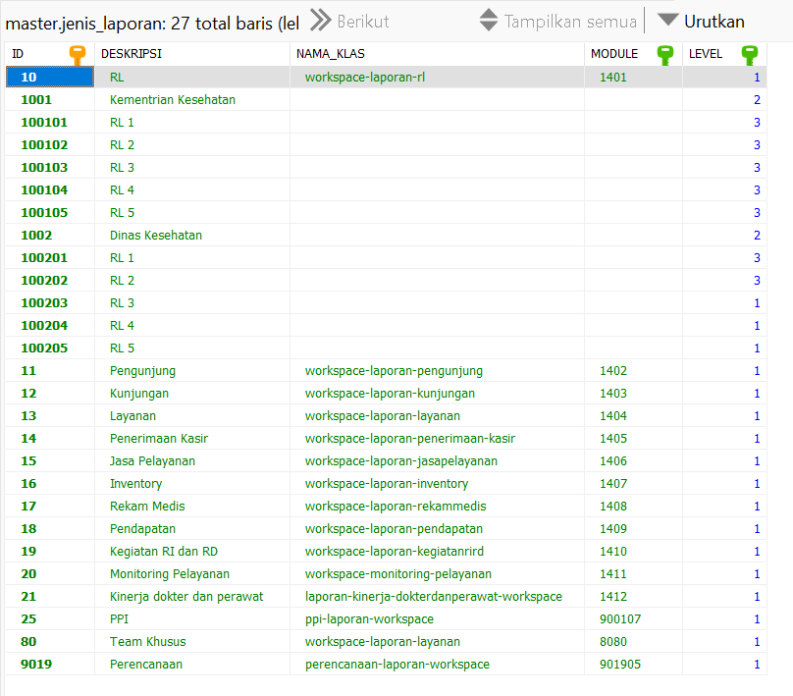
master.jenis_laporan

Slide 3
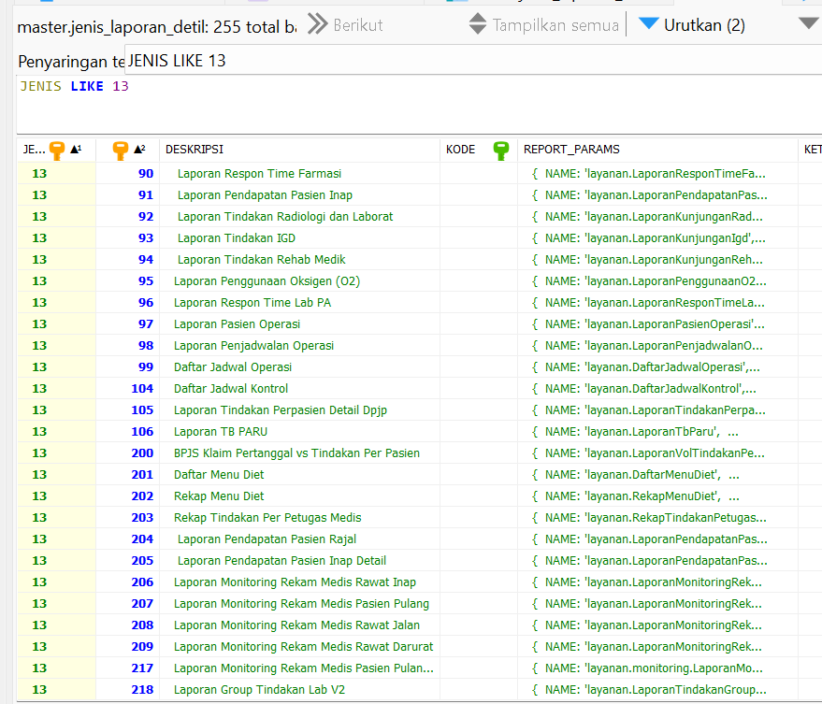

master. jenis_laporan_detil
{
NAME: 'layanan.LaporanTindakanGroupLab',
TYPE: 'Pdf',
EXT: 'pdf',
PARAMETER: {
TGLAWAL: '',
TGLAKHIR: '',
RUANGAN:'',
TINDAKAN:'',
CARABAYAR:'',
DOKTER:''
},
REQUEST_FOR_PRINT: false,
PRINT_NAME: 'CetakLayanan'
}

Slide 4
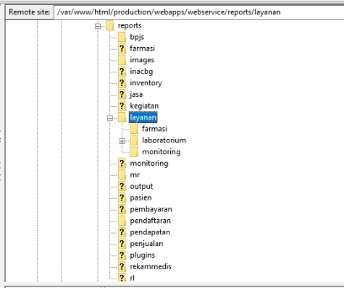
/var/www/html/production/webapps/webservice/report
{
NAME: 'layanan.LaporanTindakanGroupLab',
TYPE: 'Pdf',
EXT: 'pdf',
PARAMETER: {
TGLAWAL: '',
TGLAKHIR: '',
RUANGAN:'',
TINDAKAN:'',
CARABAYAR:'',
DOKTER:''
},
REQUEST_FOR_PRINT: false,
PRINT_NAME: 'CetakLayanan'
}
KODERS-LaporanTindakanGroupLab.jrxml

Slide 5
/var/www/html/production/webapps/webservice/report
{
NAME: 'layanan.LaporanTindakanGroupLab',
TYPE: 'Pdf',
EXT: 'pdf',
PARAMETER: {
TGLAWAL: '',
TGLAKHIR: '',
RUANGAN:'',
TINDAKAN:'',
CARABAYAR:'',
DOKTER:''
},
REQUEST_FOR_PRINT: false,
PRINT_NAME: 'CetakLayanan'
}
KODERS-LaporanTindakanGroupLab.jrxml

